Slide 1
AI Chatbot for Diagnosis of Acute Diseases
PIP104 PROFESSIONAL PRACTICE-II
VIVA-VOCE
Batch Number:
Roll Number | Student Name
20201CIT0091 20201CIT0059 | Syed Mohammed Umairullah
20201CIT0119 | Syed Asif
20201CIT0093 | Kalyan KS
20201CIT0109 | Mohammed Aukib
 | Abhilash S Pole
Under the Supervision of,
Ms. Soumya
Assistant Professor
School of Computer Science Engineering & Information Science
Presidency University

Slide 2
Introduction
This initiative seeks to overcome the challenges posed by a shortage of healthcare professionals in underserved areas, offering a potential solution to enhance healthcare accessibility.
Our project focuses on harnessing the power of artificial intelligence to create a virtual "doctor" capable of diagnosing common acute diseases remotely.
By training machine learning models on relevant medical data, we aim to provide accessible and preliminary healthcare guidance for everyday ailments, mitigating the impact of limited access to medical professionals in underserved areas.

Slide 3
Literature Review
Guo, Jonathan & Li, Bin. (2018). The Application of Medical Artificial Intelligence Technology in Rural Areas of Developing Countries. Health Equity.
2. 174-181. 10.1089/heq.2018.0037.
Drawback:
● Implementation costs, especially equipment costs, can be a significant hurdle.
How our model will overcome it:
● Our model focuses on minimizing equipment costs by leveraging existing digital infrastructure such as smartphones.

Slide 4
Literature Review
S. Kaur et al.,"Medical Diagnostic Systems Using Artificial Intelligence (AI) Algorithms: Principles and Perspectives,
" in IEEE Access, vol. 8, pp.228049-228069, 2020, doi: 10.1109/ACCESS.2020.3042273.
Drawback:
● Lack of variety in data sets.
How our model will overcome it:
● Our system uses a variety and large number of data sets, to give better diagnosis.

Slide 5
Literature Review
Sadiku, Matthew & Shadare, Adebowale & Musa, Sarhan. (2017). Mobile Health. International Journal of Engineering Research. 6. 450-452.10.5958/2319-6890.2017.00061.7.
Drawback:
● The lack of clear regulations and data protection laws, especially in developing countries, poses challenges.
How our model will overcome it:
● We will heavily research on the regulations and data protections laws in India, to make sure we are not violating any rules and regulations.

Slide 6
Literature Review
How does AI help in Rural Development in Healthcare Domain: Saurabh A Pahune, Cardinal Health, Dublin OH 43017, USA International Journal for Research in Applied Science & Engineering Technology (IJRASET) ISSN: 2321-9653; IC Value: 45.98; SJ Impact Factor:7.538
Drawback:
● Limited access to technology and the internet in rural areas poses challenges for deploying AI-powered healthcare systems. Accessibility needs to be addressed for effective implementation.
How our model will overcome it:
● Recognizing limited access to technology, our system incorporates offline capabilities, allowing people in rural areas to use and deploy AI-powered tools even in the absence of a stable internet connection.

Slide 7
Literature Review
Chakraborty, Sanjay & Paul, Hrithik & Ghatak, Sayani & Pandey, Saroj & Kumar, Ankit & Singh, Kamred & Shah, MohdAsif. (2023). An AI-Based Medical Chatbot Model for Infectious Disease Prediction. IEEE Access. PP. 1-1. 10.1109/ACCESS.2022.3227208.
DRAWBACKS:
● The accuracy of the chatbot may be limited by the quality of the training data.
How our model will overcome it:
● Use a larger and more diverse dataset of patient records to train the chatbot. This will help to improve the accuracy of the diagnosis.

Slide 8
Research Gaps Identified
Implementation costs, especially equipment costs, can be a significant hurdle.
The accuracy of the chatbot may be limited by the quality of the training data.
Limited access to technology and the internet in rural areas poses challenges for deploying AI-powered healthcare systems. Accessibility needs to be addressed for effective implementation.
The lack of clear regulations and data protection laws, especially in developing countries, poses challenges.
Lack of variety in data sets.

Slide 9
Proposed Methodology
Take User Information
Ask for Symptoms
Understand Severity of Symptoms
Predict Disease using Decision Trees
Suggest Advice Using Voice

Slide 10
Objectives
Create a chatbot that predicts health conditions based on user-input symptoms.
Chatbot should allow user to input symptoms and duration for personalized predictions.
Create a User-friendly interface for easy health status checks.
Chatbot should be easy to access and use for people in rural areas.

Slide 11
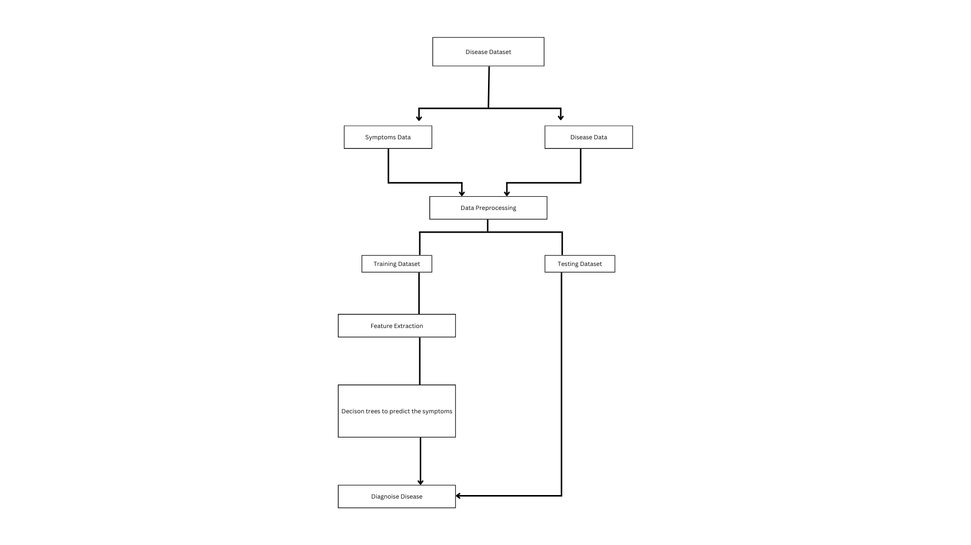
System Design & Implementation

Slide 12
Timeline of Project
Define Project Scope: 10/11/23 - 14/11/23
Collect Data: 15/11/23 - 20/11/23
Preprocess Data: 20/11/23 - 27/11/23
Choose a Model: 28/11/23 - 03/12/23
Integrate with Chatbot Framework: 04/12/23 - 19/12/23
Test and Refine: 20/12/23 - 04/01/24
Updates and Final Report: 05/01/24 - 08/01/24

Slide 13
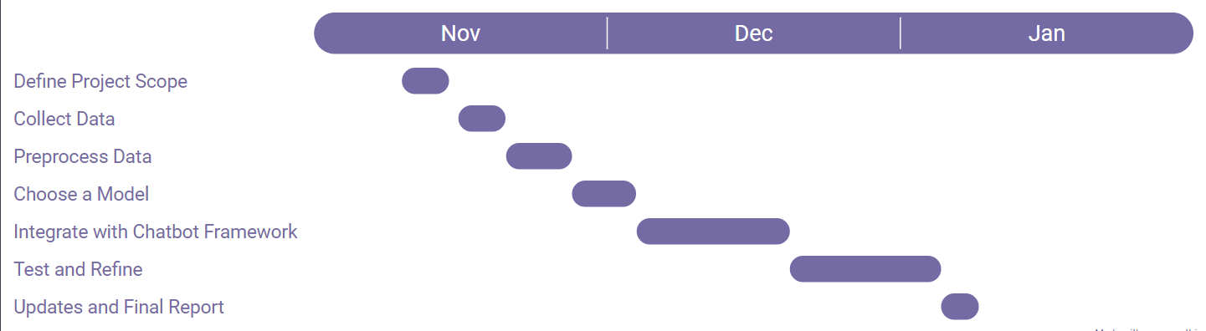
Timeline of Project

Slide 14
Outcomes / Results Obtained
● Predicts health conditions based on user-input symptoms.
● Allows users to input symptoms and duration for personalized predictions.
● User-friendly interface for easy health status checks.
● Easy to access and use for people in rural areas.

Slide 15
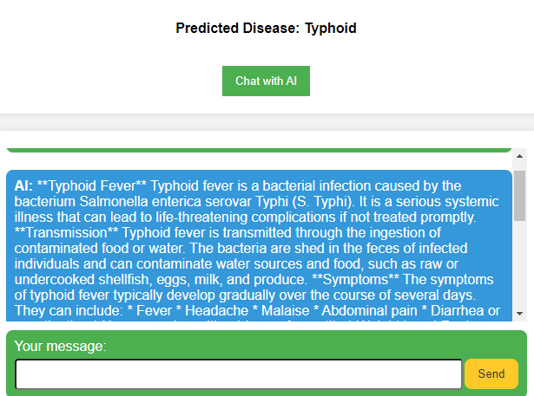
Outcomes / Results Obtained

Slide 16
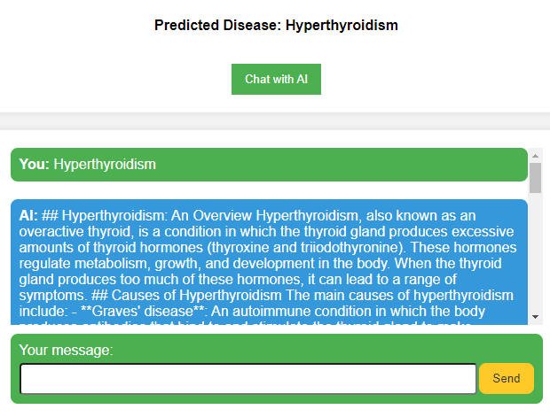
Outcomes / Results Obtained

Slide 17
Conclusion and Future Developments
In a landscape where limited doctor availability poses a challenge to healthcare access, the integration of artificial intelligence emerges as a promising solution.
Leveraging the capabilities of digital assistants like Google and Alexa, an AI-based "doctor" can effectively diagnose common ailments, providing accessible healthcare solutions.
This innovation not only addresses the scarcity of medical professionals in smaller towns and villages but also aligns with the digital era, ensuring widespread and timely healthcare support.
In the future this model, can provide a direct link between the people in rural areas to top doctors in cities via common devices like smartphones, laptops etc.
We hope this model will have a positive impact in our country and improve the lives of people in rural areas.

Slide 18
References
Kumar Y, Koul A, Singla R, Ijaz MF. Artificial intelligence in disease diagnosis: a systematic literature review, synthesizing framework and future research agenda. J Ambient Intell Humaniz Comput. 2023;14(7):8459-8486. doi:10.1007/s12652-021-03612-z
Guo, Jonathan & Li, Bin. (2018). The Application of Medical Artificial Intelligence Technology in Rural Areas of Developing Countries. Health Equity. 2. 174-181. 10.1089/heq.2018.0037.
Sadiku, Matthew & Shadare, Adebowale & Musa, Sarhan. (2017). Mobile Health. International Journal of Engineering Research. 6. 450-452. 10.5958/2319-6890.2017.00061.7.
How does AI help in Rural Development in Healthcare Domain: A Short Survey Saurabh A Pahune, Cardinal Health, Dublin OH 43017, USA, International Journal for Research in Applied Science & Engineering Technology (IJRASET) ISSN: 2321-9653; IC Value: 45.98; SJ Impact Factor: 7.538

Slide 19
References
Pathak, Chandramaprasad and Ansari, Namrata, Chatbot based Disease Prediction and Treatment Recommendation using AI (May 7, 2021). Available at SSRN: https://ssrn.com/abstract=3869072 or http://dx.doi.org/10.2139/ssrn.3869072
Fan X, Chao D, Zhang Z, Wang D, Li X, Tian F. Utilization of Self-Diagnosis Health Chatbots in Real-World Settings: Case Study. J Med Internet Res. 2021 Jan 6;23(1):e19928. doi: 10.2196/19928. PMID: 33404508; PMCID: PMC7817366.
Chakraborty, Sanjay & Paul, Hrithik & Ghatak, Sayani & Pandey, Saroj & Kumar, Ankit & Singh, Kamred & Shah, Mohd Asif. (2023). An AI-Based Medical Chatbot Model for Infectious Disease Prediction. IEEE Access. PP. 1-1. 10.1109/ACCESS.2022.3227208.
Das A, Acharya UR, Panda SS, Sabut S. Deep learning based liver cancer detection using watershed transform and Gaussian mixture model techniques. Cogn Syst Res. 2019;54:165–175. doi: 10.1016/j.cogsys.2018.12.009.

Slide 20
Publication Details
IJSRED Certificate
Paper ID - IJSRED-V7I1P6
Online Edition - http://www.ijsred.com/jan-feb-2024.html
Published Link : http://www.ijsred.com/volume7-issue1-part1.html
Certificates Link: https://drive.google.com/drive/folders/1TXQH5GEorLIiSoejf9a4jKLrkLUHbvQ7?usp=sharing

Slide 21

Thank You

